Slide 1
Inwood Beach Club Group #4
Valeria Delgado
Nick Hayes
Minji Kang
Caitlin O’Connell
Dan Viggiani

Slide 2
Agenda Slide
Background
Business Value
Website
Conclusion

Slide 3
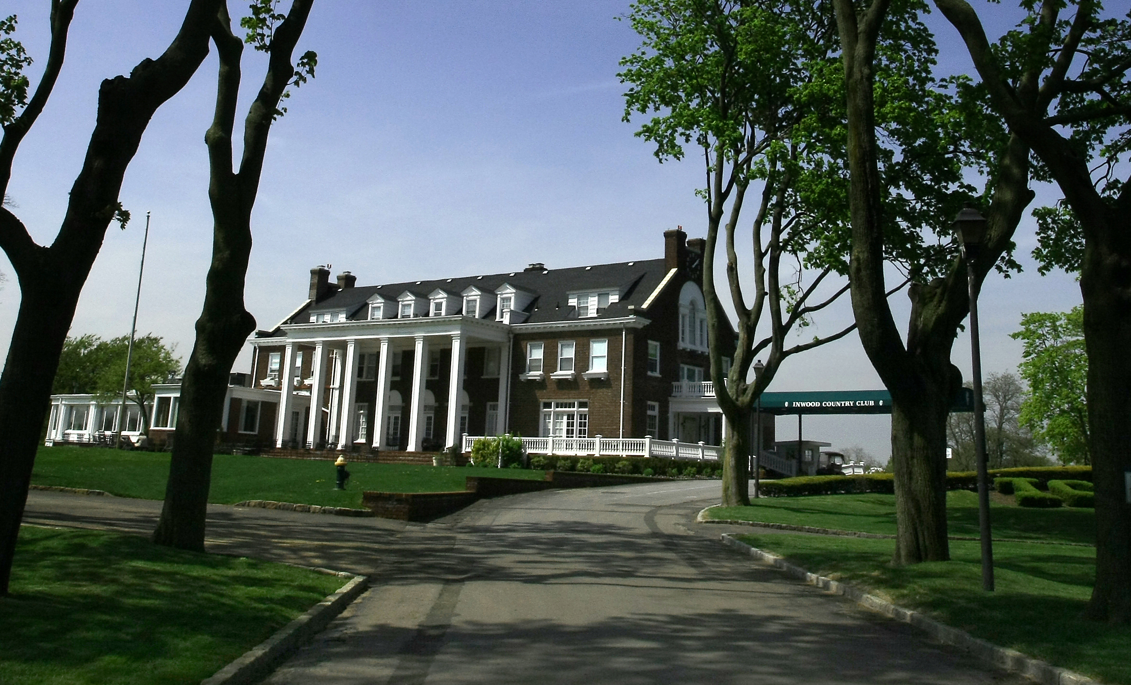
Background
1795 Ocean Blvd, Atlantic Beach, NY 11509
Pristine beachfront
Atlantic Ocean
Pool
Cabanas
Lockers
Restaurant and Bar

Slide 4
Business Value
Consistency
Orderliness
Organization
Simplicity

Slide 5
Website
http://inwoodbeachclub.weebly.com/contact.html

Slide 6
Conclusion
Payment Information in Members Table
Last four digits for credit card information
Limit sixteen digits
Calculated Field in Guests Table
Date of birth in relation to price

